Slide 1
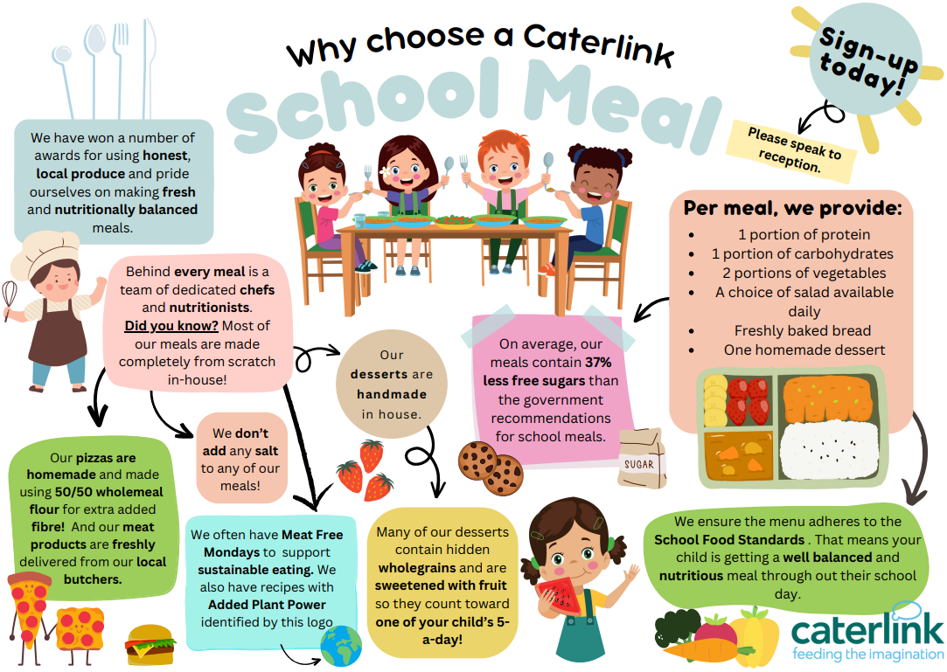

Slide 2

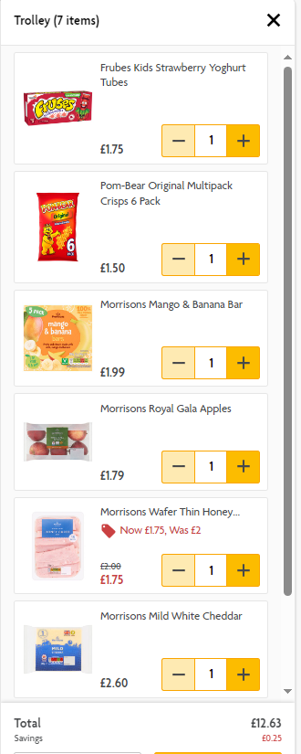
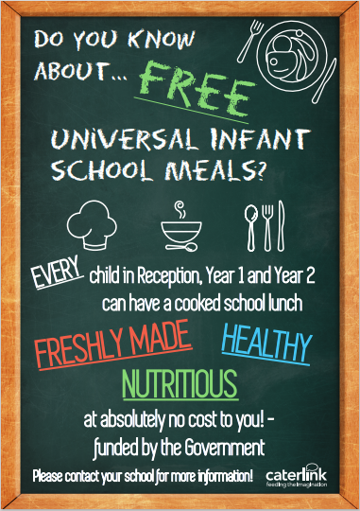
£12.60 per week x 38 school weeks = £478.80 annually!!
The Average basket cost for a daily packed lunch – Based on Morrisons on 15th May .

