Slide 1
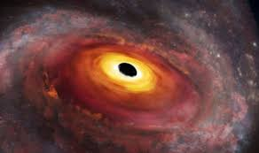
My Very Electric Mood Just Uttered Nureonic Cell

