Slide 1
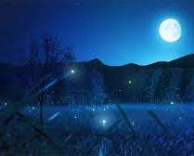
My nocturnal animal
Mack’s

Slide 2
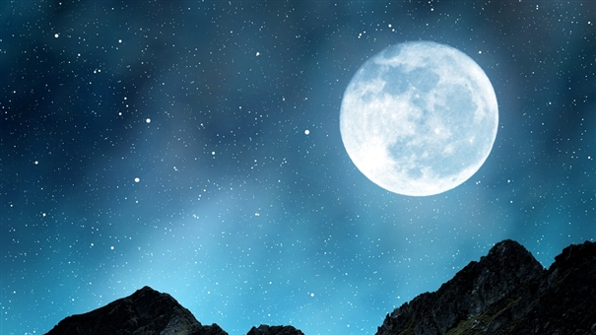
What it looks like
My nocturnal animal has a grey and blue stripe pattern and looks like a wolf but has red furry legs and lurks in their burrow in the daytime but when it comes out it has snarling teeth . It has a long snout and deep black nose.

Slide 3
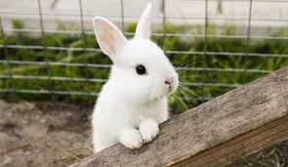
Its prey
My nocturnal animal eats rabbits as it is the size of a wolf .It also eats vegetation, especially vegetables.

Slide 4
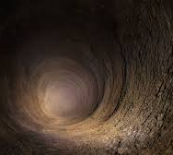
Its habitat
It lives in temperate countries in holes and dig a network of tunnels to transport themselves around. My nocturnal Animal is called… the moonlit walf pronounced wa-lf.

