Slide 1
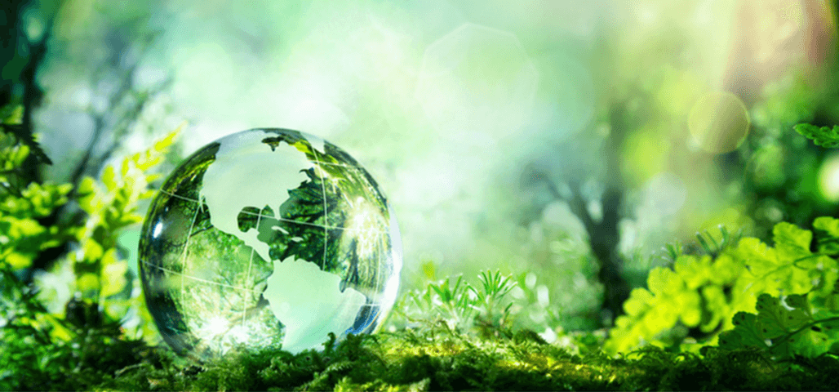
Environmental Art

Slide 2
Environmental Artists
What is an environmental artist?
Environmental artists raise awareness of some of the environmental problems our planet faces through their art.
What kind of problems do you think our planet faces at the moment?
Discuss your ideas with an adult…

Slide 3
The artists use natural materials which are found in nature to create their artwork. Their artwork will usually be found within nature itself, rather than in an art studio. What kind of natural materials do you think the artists may use?
Environmental art was first introduced in the 1960’s (over 60 years ago) and is sometimes known as Land Art, Earth Art and/or Sustainable Art.

Slide 4
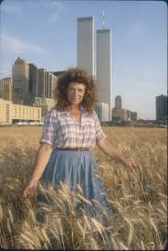
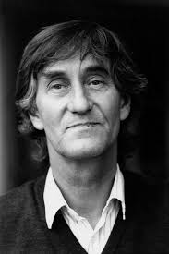
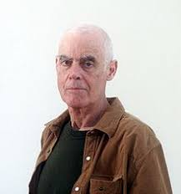
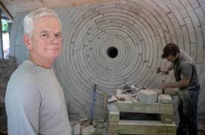
Who will we be learning about?
Over the next few weeks, we will be learning about a number of Environmental artists. These will include Nils Udo, Richard Long, Andy Goldsworthy and Agnes Denes.

Slide 5
Our First Activity
As an introduction to our environmental art topic, you are going to create a sound map. Take a piece of paper out into your garden (or on a walk in your local area) and listen carefully to what natural sounds you can hear.
You are going to represent these sounds with graphic scores (pictures, symbols, shapes, words and marks).

Slide 6
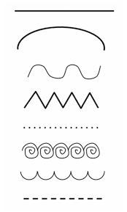
Graphic Scores
When creating your graphic scores to represent the sounds of nature, think carefully about the sound and how you could portray this.
Is the sound long or short, quite or loud, high or low (pitch)?

Slide 7
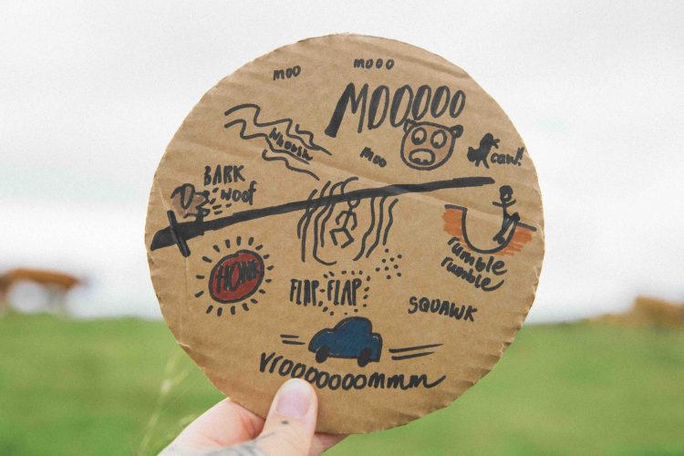
Creating your own Sound Map
This may not be the best example of a sound map, but it demonstrates the use of graphic scores to represent sounds.
The idea is that you draw a picture of yourself in the middle of the paper, before representing the sounds around you, in the direction which you think they are coming from.

Slide 8
Creating your own Sound Map
Once you have completed your sound map, make sure that it is coloured neatly. You can also label your graphic scores using a separate key if you would like to let other people know what sounds you heard.

