Slide 1
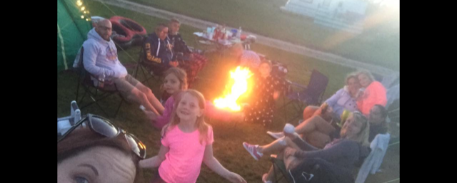
Bude - Cerenety campsite
Family camping holiday

Slide 2
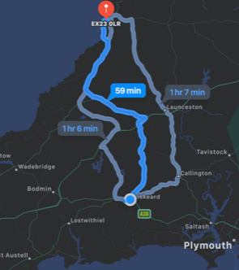
Travelling
. From home to Cerenety campsite it is 36 miles by car.
. Milky way is 18 miles by car.
. Bude tunnels is 1.4 miles on foot.
. Bude castle is 0.7 miles on foot.
. In total it is 108 miles in car and on foot it is 4.2 miles
. It would take you 188 minutes (3 hours and 8 minutes)

Slide 3
Non-chronological report
We travel to Cerenety campsite in Bude hopefully it is nice weather in Bude it took forever to get there in the car. We went through Callington, Launceston then onto Bude.
Then we went to Bude tunnels are completely undercover but protect from the elements whilst maintaining your view of the spectacular surroundings. It is 70m long Then we looked at Bude castle looks very important

Slide 4
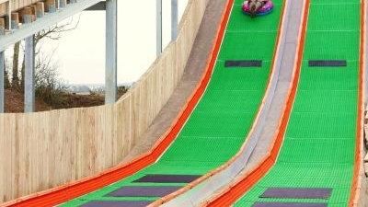
Milky way adventure park looks like a great family attraction, the Ziggy’s blast quest, an interactive experience where you’ll help save planet Earth by piloting cyber scooters and shooting at space rocks and blasteroid lasers. Gravity rider is a 30ft tall donut slide that will satisfy any daredevils!

Slide 5
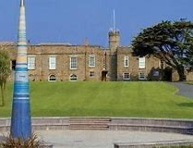
Bude castle
This beautiful castle looks amazing, it is nested in the sand dunes next to Summerlease beach and run alongside the Bude canal. They have exhibitions which you can enjoy and activities for children in the holidays.
It also has the Heritage center, which sounds very interesting, with information about Bude’s canals, beaches and town. It also has an area dedicated to Sir Goldsworthy Gurney who built the castle in 1830.

Slide 6
Poem
The fresh dew, blankets the grass
Woken by the morning chorus
The waft of bacon spreads through the campsite
The sun gazing on my hand
Fluffy clouds in the sky drifting
People laughing

Slide 7
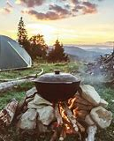
Food
Breakfast – Bacon, eggs, beans and toast.
Lunch – ham sandwiches
Tea – BBQ
Snacks – Crisps, apples and squash.

Slide 8
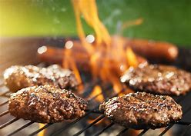
Money of food
Food and drink for 4 people, 2 nights
Bacon– 8 rashes x2 @ £1.17 =£3.50
Eggs – 15 eggs @ 85p each
Beans – 2 cans @ 85p each = £1.70
Bread – 2 loafs @ 59p each = £1.18
Ham – 12 slices @ £3.00
Burger – 4 burgers @ £3.00 = £6.00
Sausages – 4 sausages x2 @ £1.70 = £3.40
Baps – 4 baps x2 @ 70p each = £1.40
Finger rolls – 4 rolls x2 @ 69p each = £1.38
Crisps Walkers multipack – 24packs @ £3.50
Apples – 6 @ 45p each = 90p
Squash – @ 80p
TOTAL COST = £28.24

Slide 9
Instructions for putting up a tent
. Get to your allocated pitch.
. Lay out the ground cloth.
. Position the tent over the ground cloth, think about were to put the entrance door.
. Lay out the poles and put them together.
. Then thread the poles through the tent body follow your tent instructions.
. Push your poles into arches then secure into pegs, do this for each side. Lots of extra hands are useful!!
. Secure the tent fly with tent pegs, making sure it is taut.
. Inside our tent we have two sleeping compartments, toggle them in and straighten ground sheet in them.
. Then sort out the guy ropes.
. Enjoy your trip !!

Slide 10
Design for a camping chair

