Slide 1
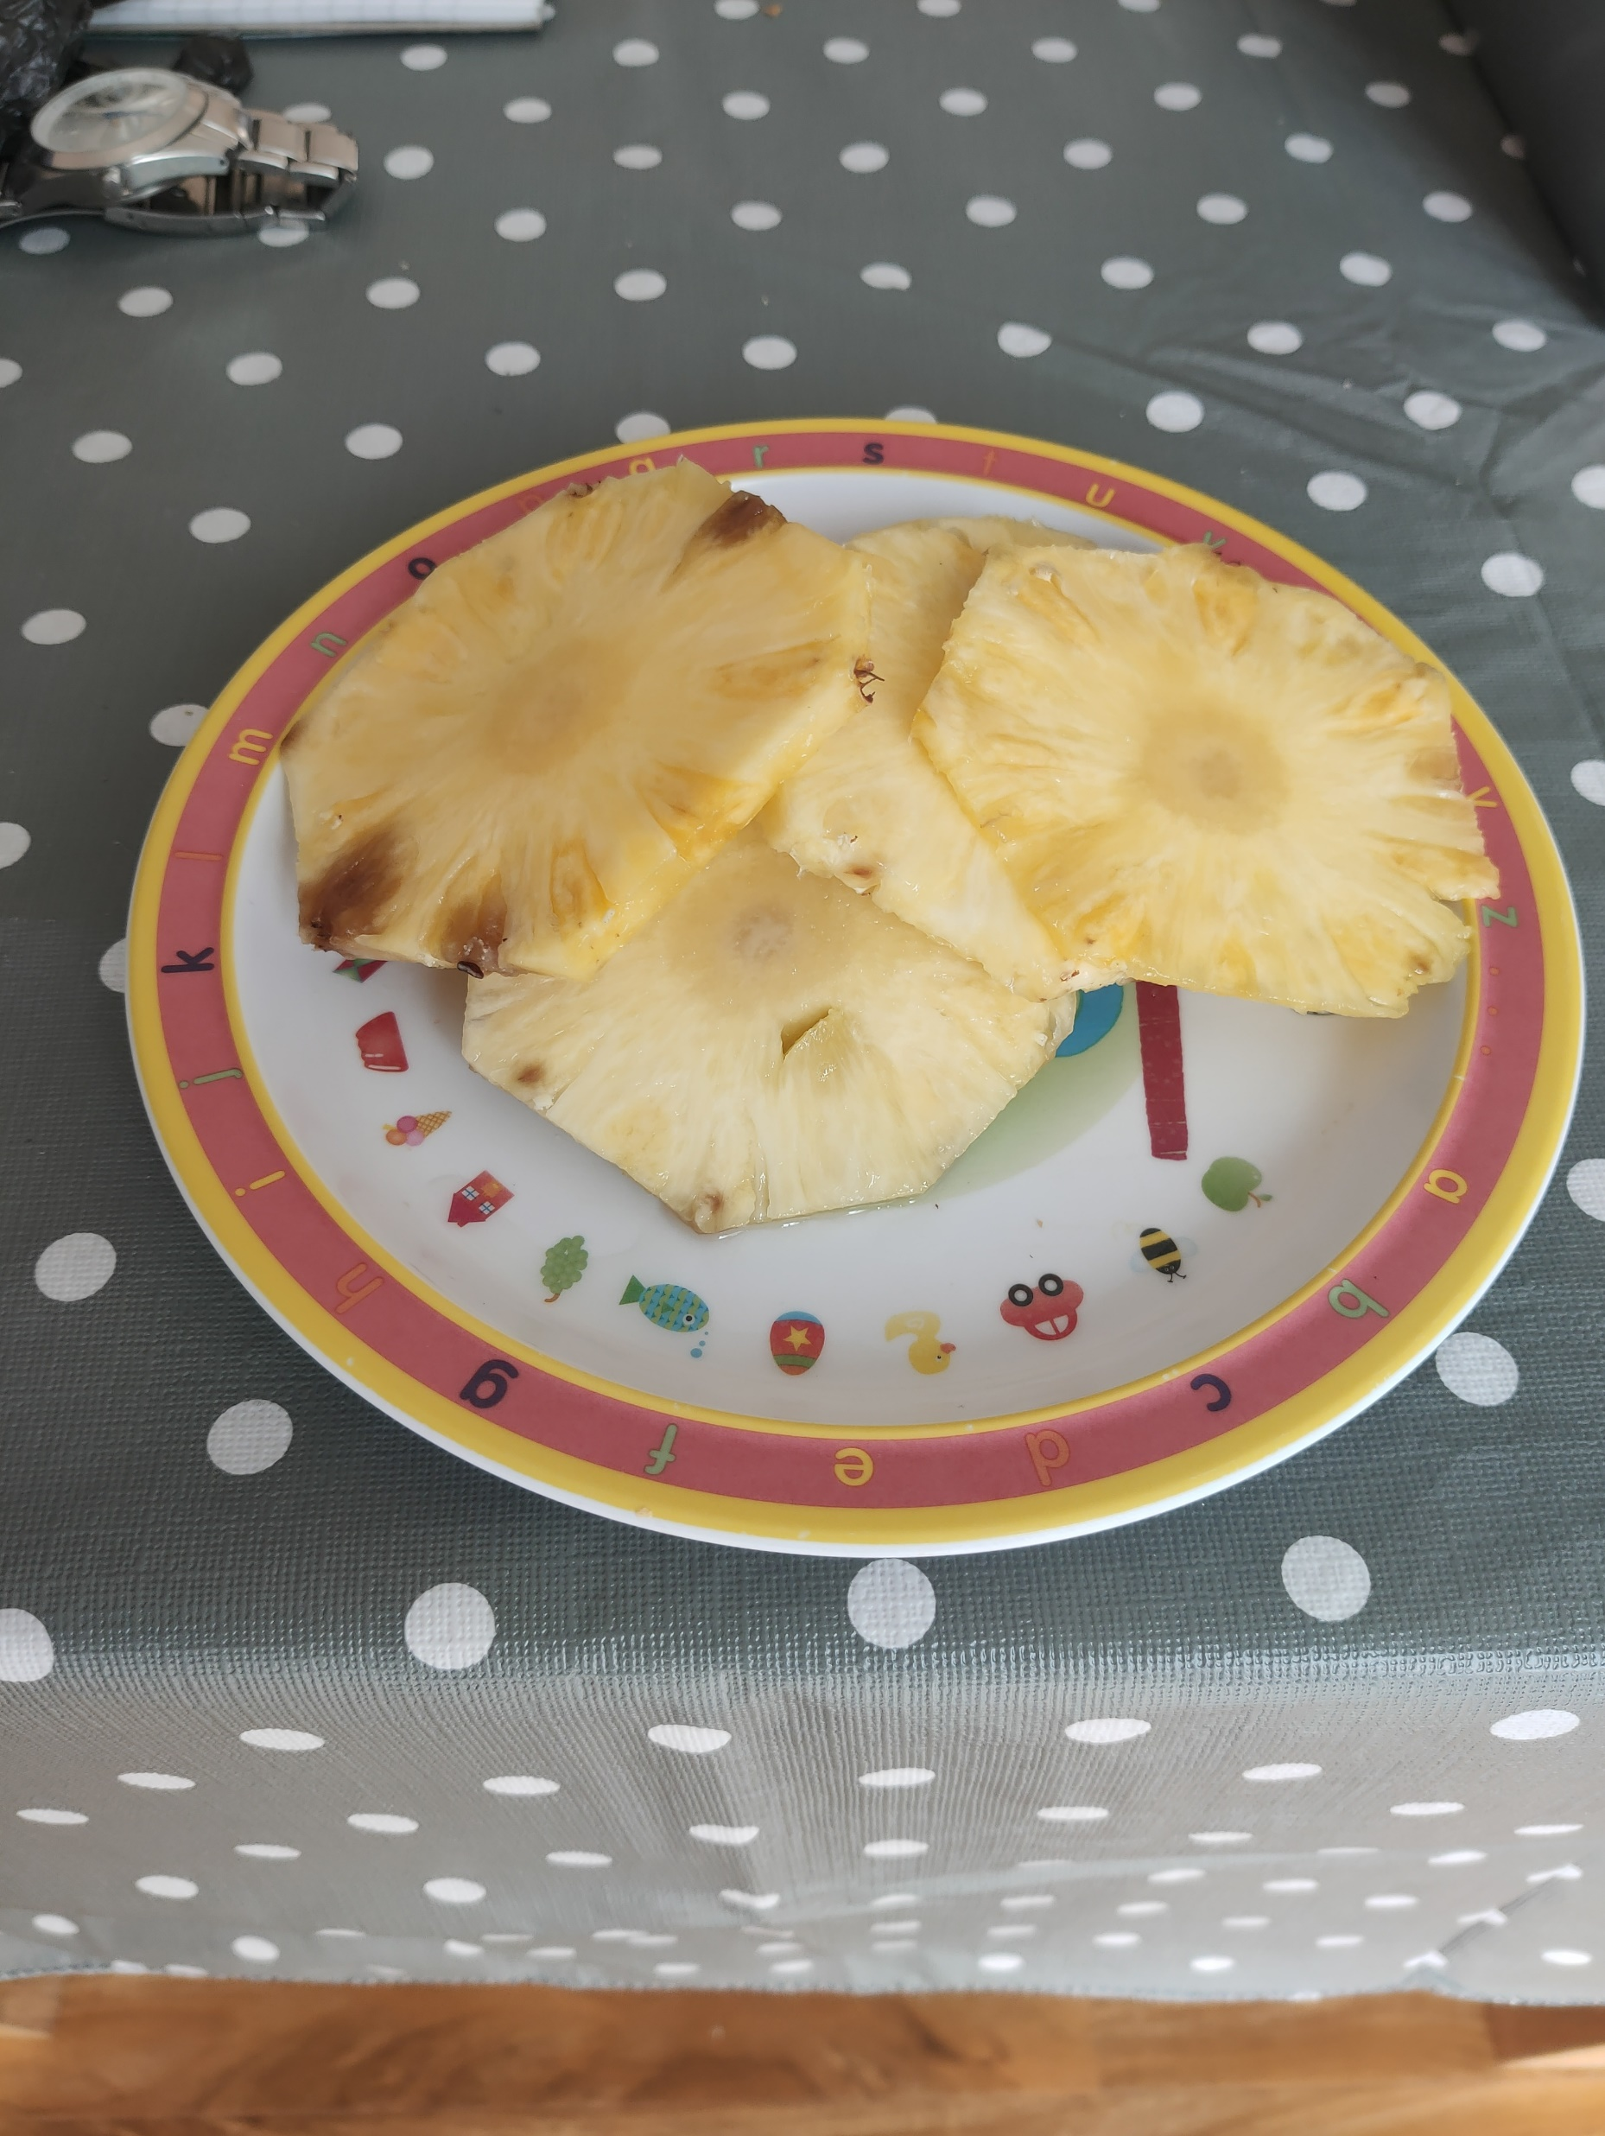
Pineapple shadows
By Lachie Fox Grant

Slide 2
Method
The first thing we did was get a Pineapple from our fruit bowl.
Then we got a torch and a phone to take pictures.
We found the darkest place in the house to get the best shadows possible.
Now we shone a torch at the pineapple.
Then we moved the torch closer, further away, higher, lower and at different angles.
When we were looking at the shadows we took photos of our results.

Slide 3
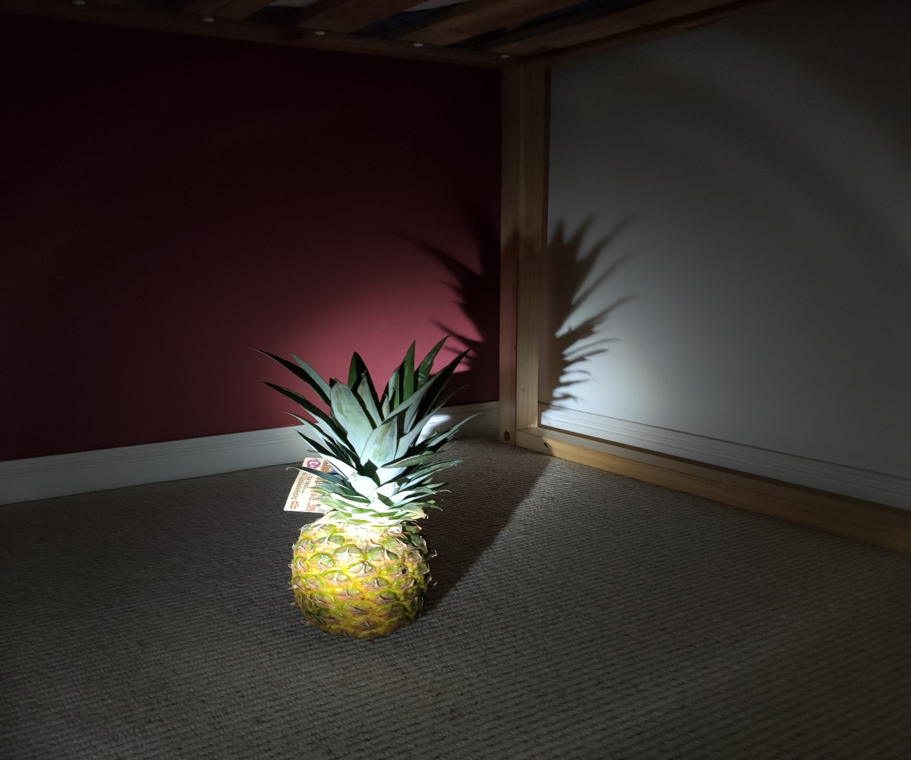
Photo one : normal shadow

Slide 4
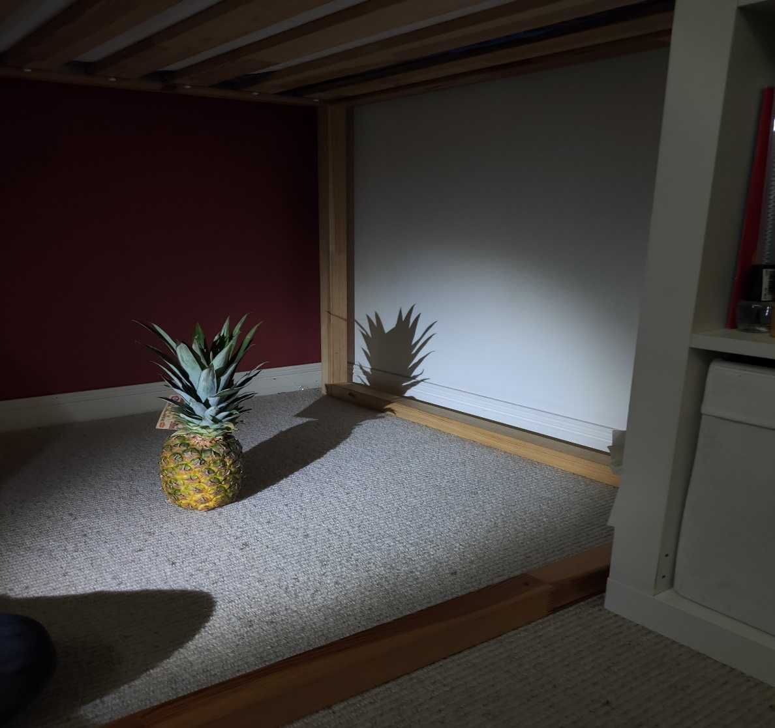
Photo two : torch further away

Slide 5
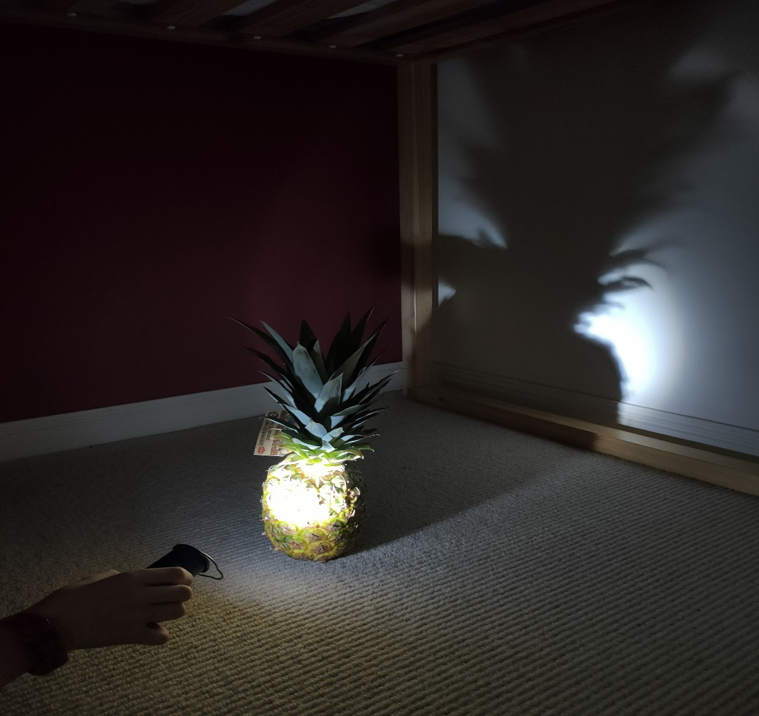
Photo three :torch closer

Slide 6
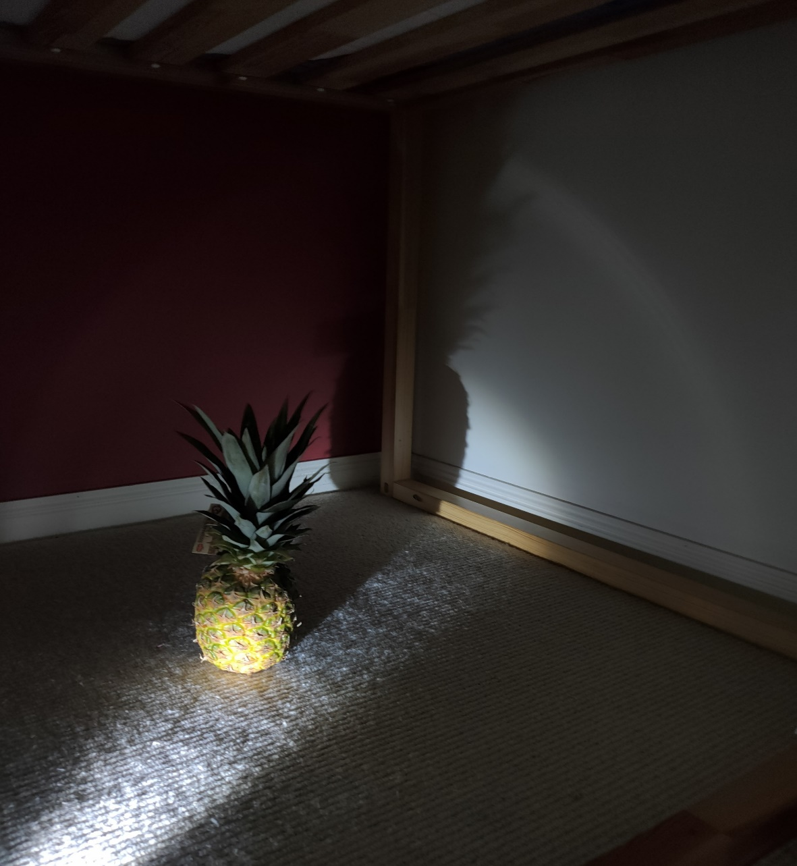
Photo four :torch lower

Slide 7
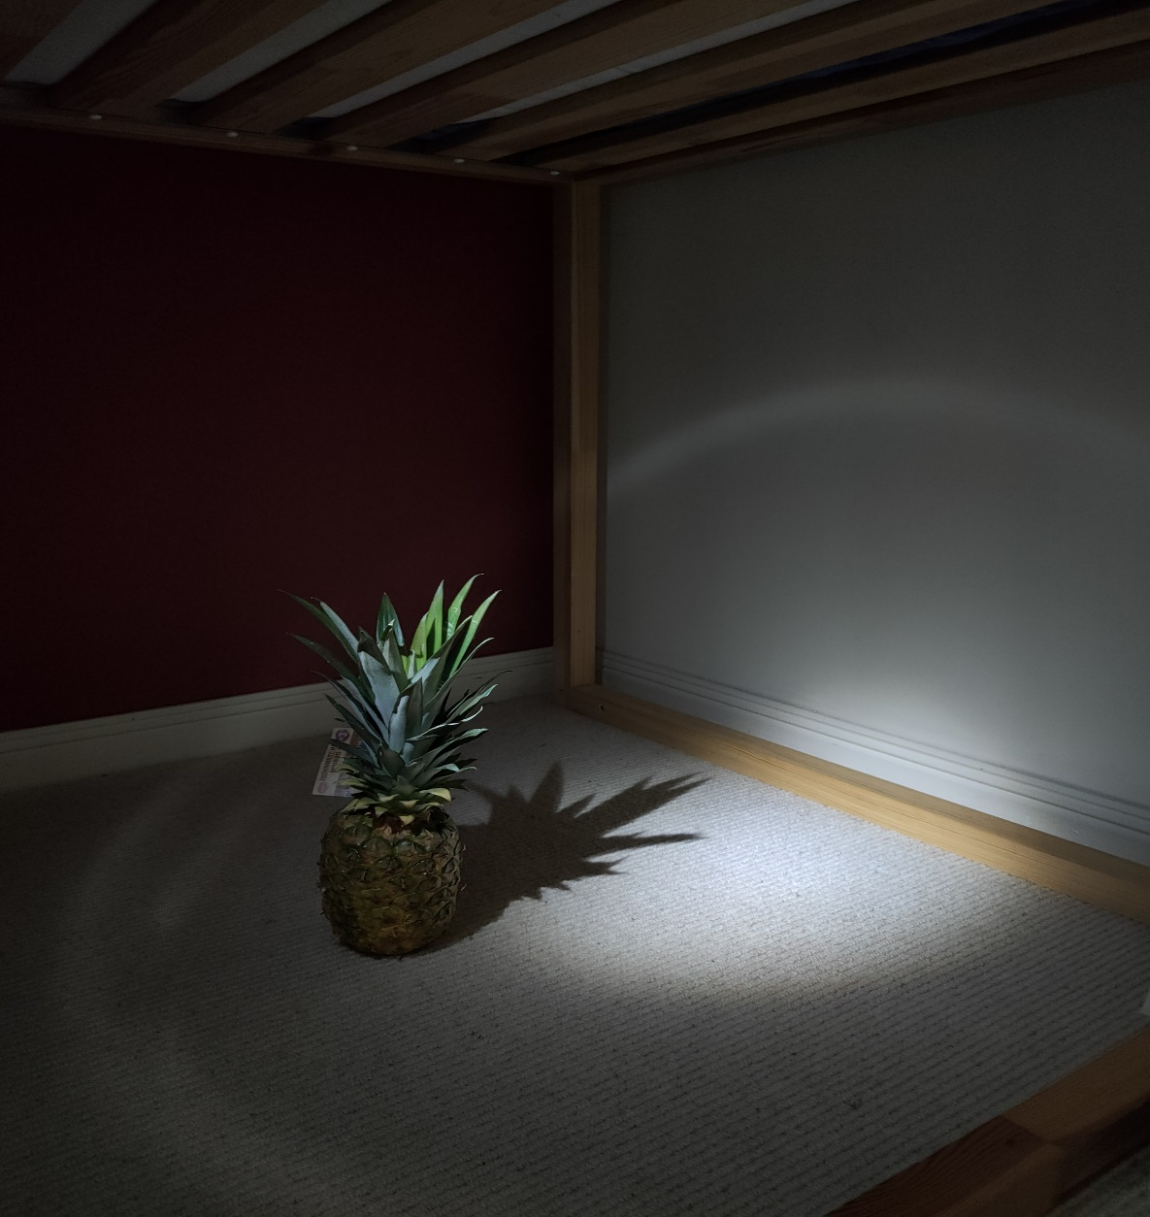
Photo five :torch higher

Slide 8
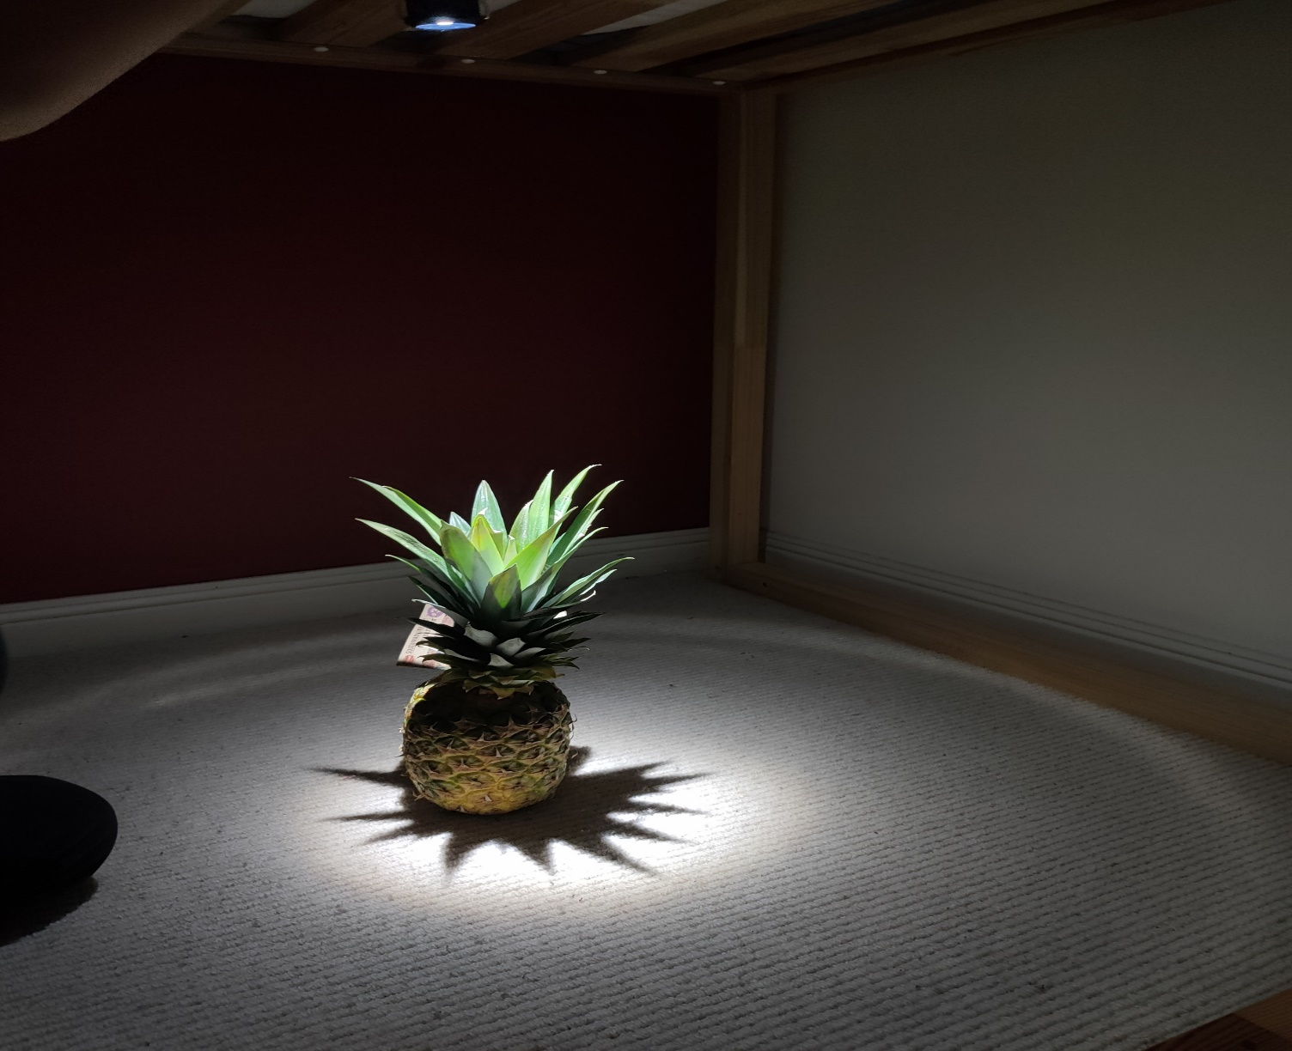
Photo six :torch directly above

Slide 9
Results
When we moved the torch away the shadow got smaller.
When we moved the torch closer its shadow got bigger.
When we moved the torch higher the shadow got squished on the floor.
When we moved the torch lower the shadow got squished on the wall.
When we moved the torch directly above the pineapple the shadow was all but invisible.

Slide 10
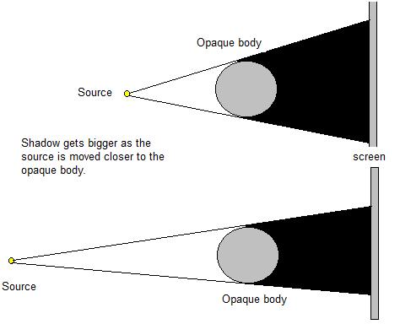
Why the shadows changed

