Slide 1
Shadows

Slide 2
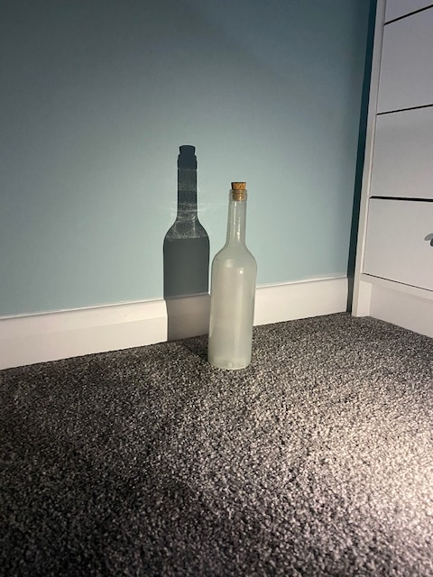
A close shadow
I used a light to create a shadow of a bottle. The shadow is created by a mixture of light and darkness to make a shadow like this.
When you go closer it gets bigger.

Slide 3
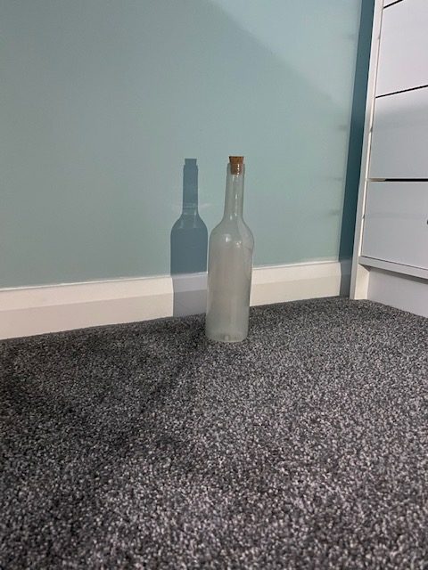
A far shadow
The shadow is the same size as the bottle when the light source is far away.

Slide 4
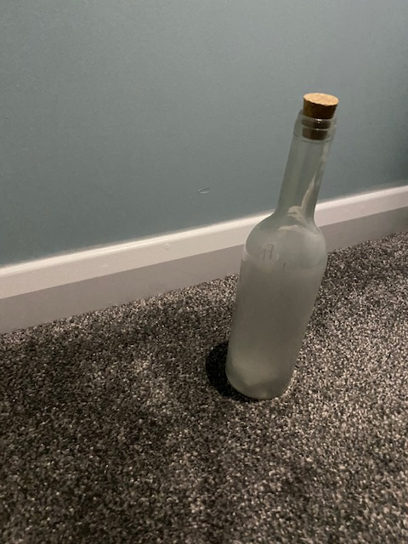
A shadow from above
The shadow has gone underneath the bottle

Slide 5
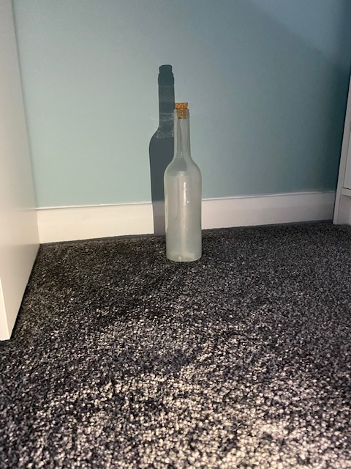
A low shadow
The shadow is larger when the light source was low.
When I was doing my investigating I tried to keep all my factors the same so I had accurate results, e.g same place when taking my picture, same object

Slide 6
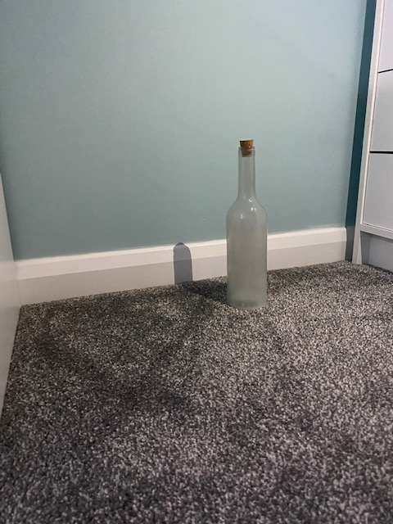
Different angle with a low light souce
The shadow is behind and small

Slide 7
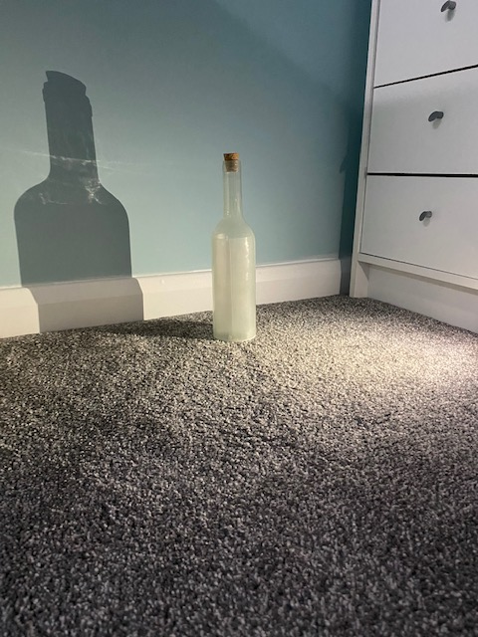
Different angle with a high light source
The shadow is behind it and bigger

Slide 8
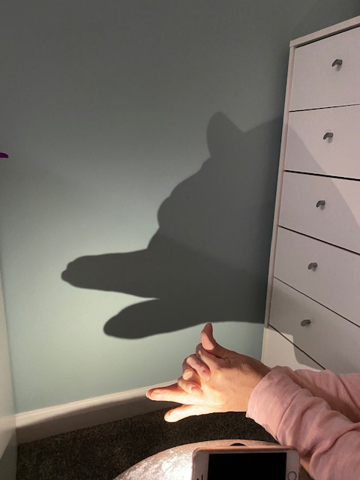
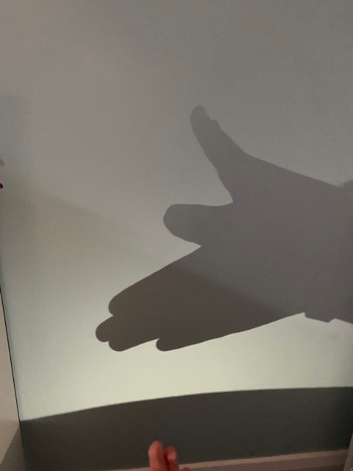
Animal shadows I created
Wolf
Butterfly

Slide 9
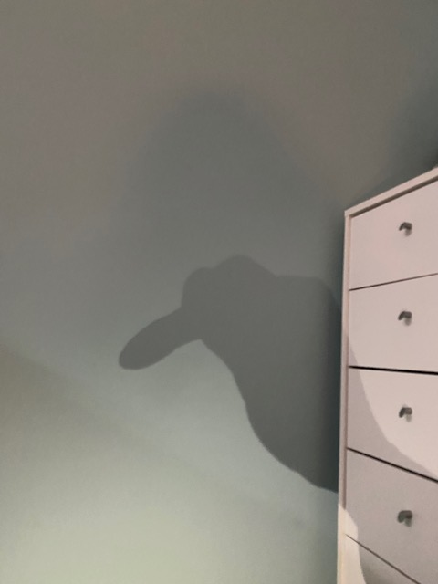
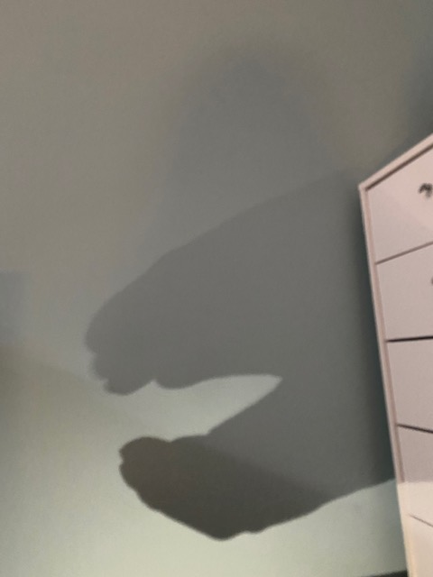
More……
Bird
Dinosaur

